Slide 1
Build Stack game using three.js
Giảng viên: TS. Mai Tiến Dũng
Nhóm sinh viên thực hiện:
Đồng Quốc Tuấn - 18520185
Huỳnh Minh Trí - 18520176
Nguyễn Phúc Đạt - 18520573

Slide 2
Table of contents
Introduction
Rendering
Camera
Light
Box
Animation
Do some calculations
Demo

Slide 3

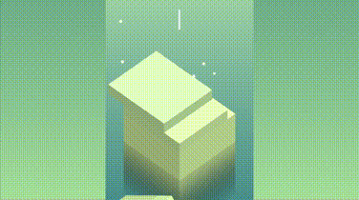
Introduction

Slide 4
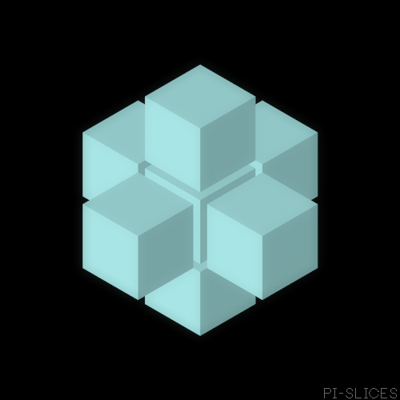
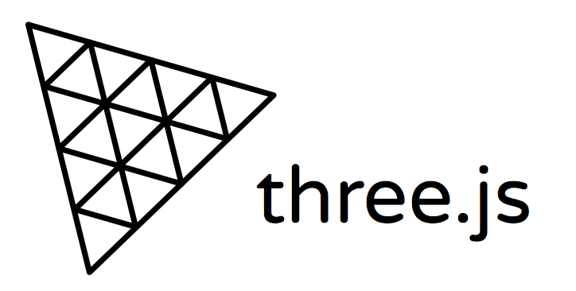
Introduction
Three.js is a Javascript library that help create and display animated 3D graphics.
It uses WebGL under the hood.

Slide 5
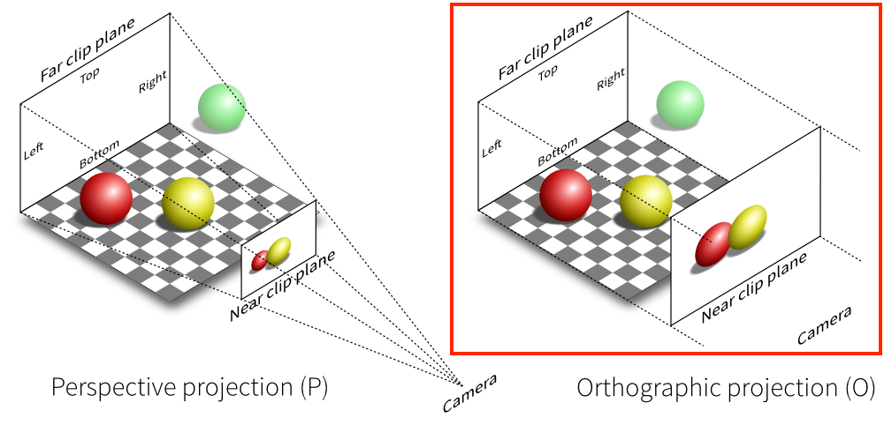
II. Rendering
Camera
PerspectiveCamera
OrthographicCamera -> Why ?

Slide 6
II. Rendering
Camera
# Why OrthographicCamera ?
Things look the same size no matter how far it from camera.
Not distorted geometries.

Slide 7
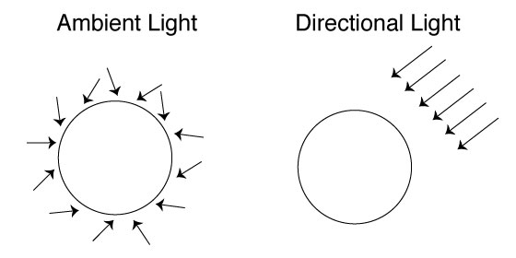
II. Rendering
Light
Ambient light shines from every direction have base color and intensity.
Directional Light shines from given position where we initialized.

Slide 8
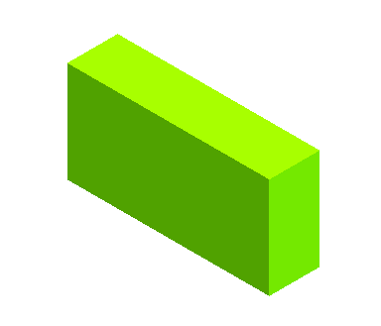
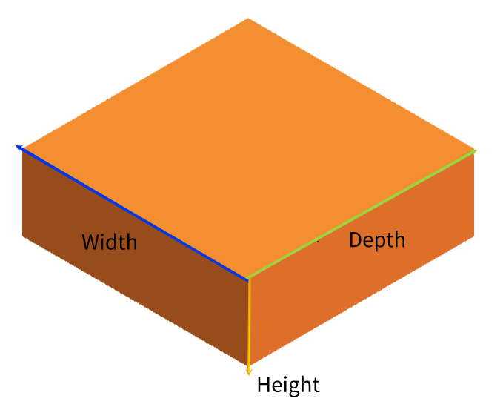
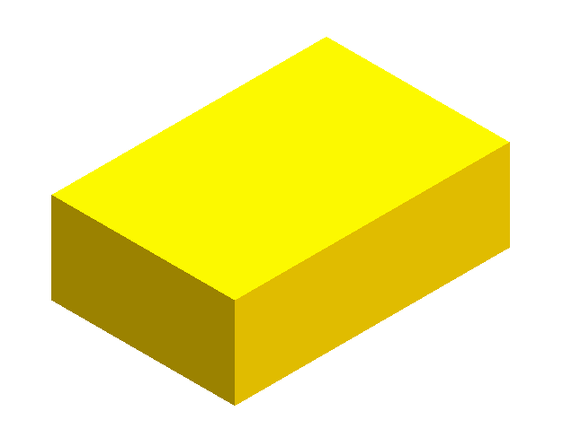

II. Rendering
Box - Geometry
Three.js has BoxGeometry( width, height, depth) and color.
Height have a fixed size during the game.
Width, Depth, Color will change until game over.

Slide 9
II. Rendering

Slide 10
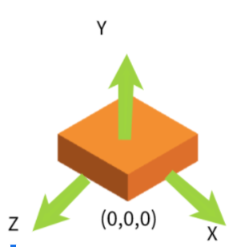
II. Rendering
Box - Position

Slide 11
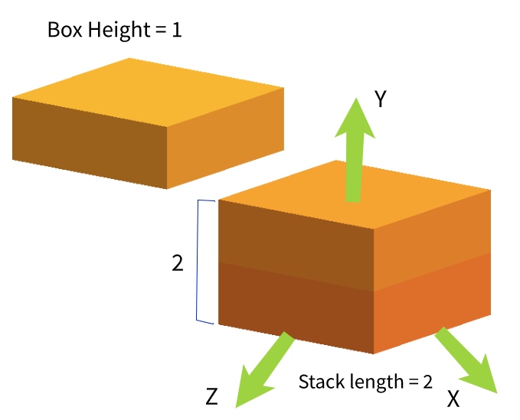
II. Rendering
Box - Position

Slide 12
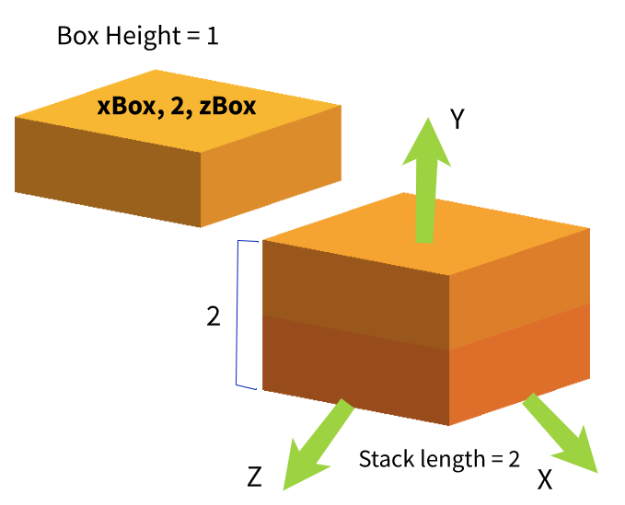
II. Rendering
Box - Position

Slide 13
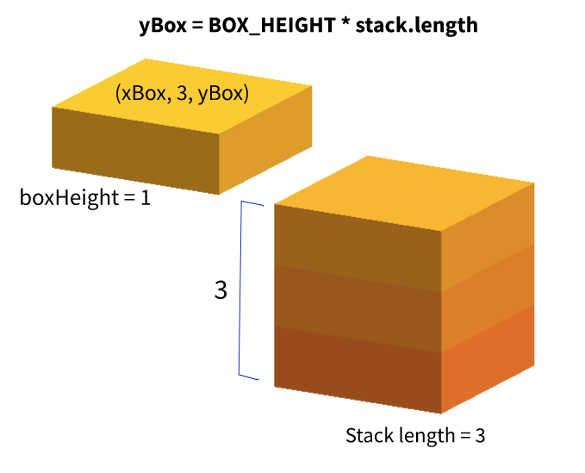
II. Rendering
Box - Position

Slide 14
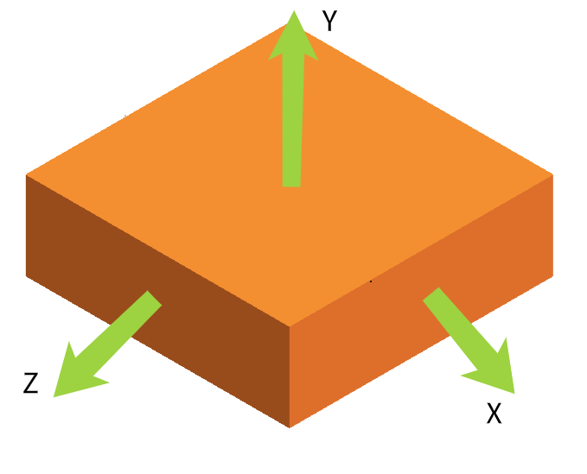
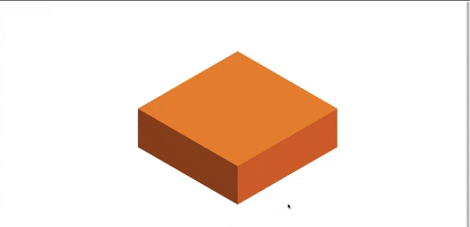

II. Rendering

Slide 15
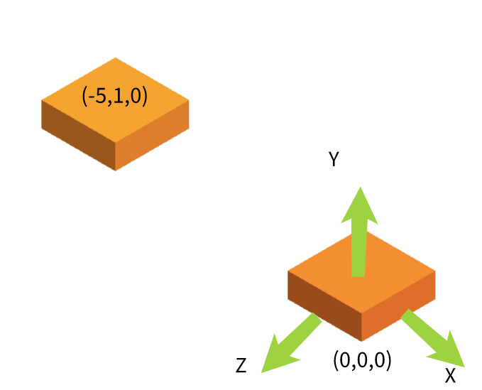
II. Rendering
Box - Position

Slide 16
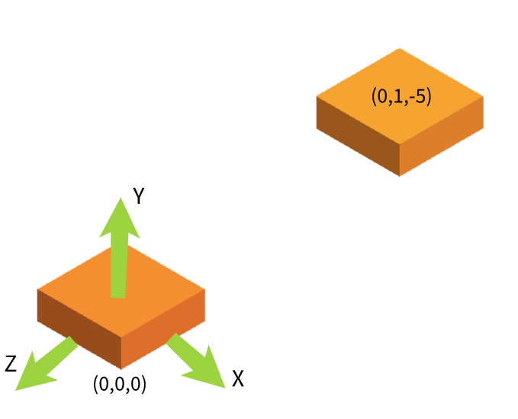
II. Rendering
Box - Position

Slide 17
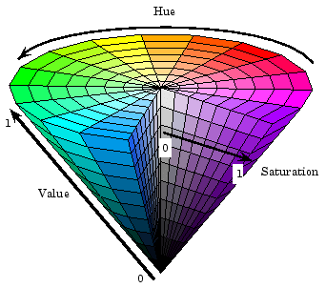
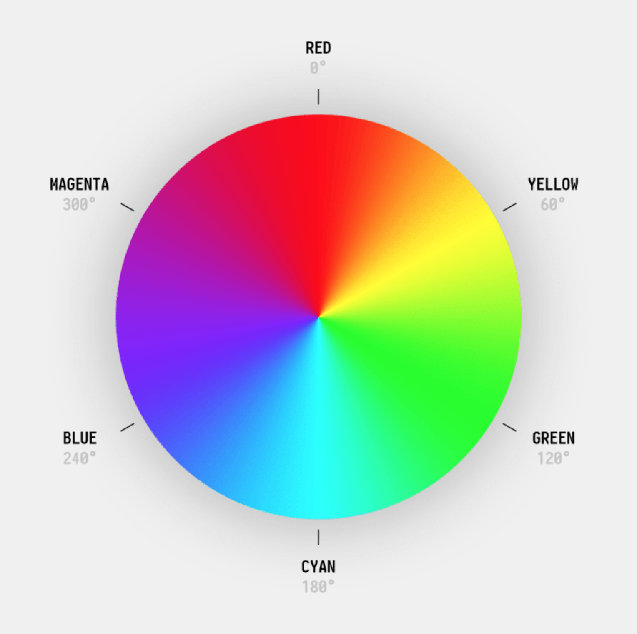
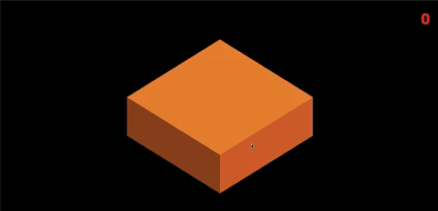
II. Rendering
Box - Color
Applying HSL color for color change at each stack layer
next_color = hsl(30 + stack.length * 4, 100%, 50%)

Slide 18
II. Rendering
Box
class Box {
position: {
x: int,
y: int,
z: int
},
color,
width: float,
depth: float,
direction: ‘x’ || ‘z’
}

Slide 19
III. Animation

Slide 20
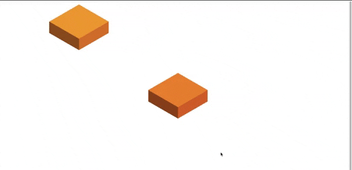
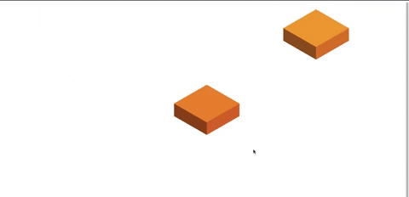
III. Animation
box.position[box.direction] += speed
Direction : ‘x’
Direction : ‘z’

Slide 21

III. Animation
# Every click event:
Stop the moving box
Add new layer
Change camera position

Slide 22
III. Animation
Have to do some calculations to see if moving box is overlapping the below one or not. If not, game over.
If its overlap we split into 2 pieces. Which part overhangs will remove.

Slide 23
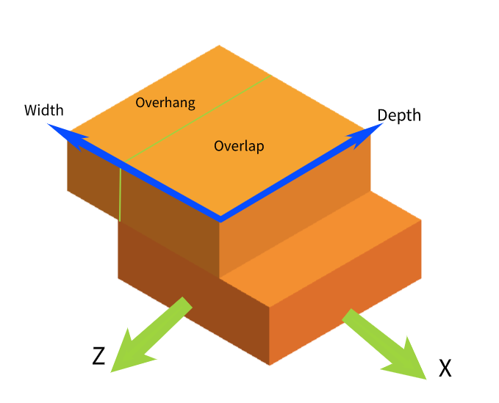

IV. Do some calculations

Slide 24
IV. Do some calculations
Direction ‘x’
delta = topLayer.position.x - previousLayer.position.x
=> overhangSize = abs(delta)
=> overLap = topLayer.width - overhangSize
topLayer.width = overLap
topLayer.position.x -= delta/2

Slide 25
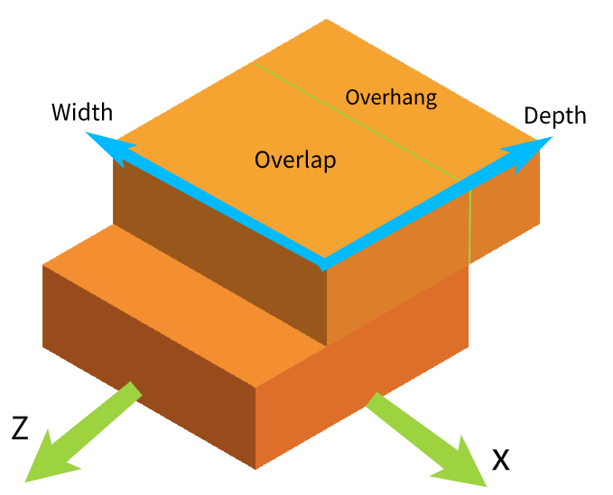

IV. Do some calculations
Direction ‘z’
delta = topLayer.position.z - previousLayer.position.z
=> overhangSize = abs(delta)
=> overLap = topLayer.depth - overhangSize
topLayer.depth = overLap
topLayer.position.z -= delta/2

Slide 26
V. Demo
Available on: https://stack-game-threejs.herokuapp.com/

Slide 27


